Slide 1

Online Payment Fraud Detection
Presented By. Under the guidance of
S.SAM RANJITH PAUL Mrs. G. PRISKILLAL, M.E.,NET,
S.PRAVIN VISWA

Slide 2


ABSTRACT:
Online Payment Fraud Detection
This project explores the application of Machine Learning techniques for detecting fraudulent activities in online payment transactions.
As digital payments surge, so does the risk of fraud, necessitating advanced detection methods.
Our project focuses on leveraging algorithms like Logistic Regression and Decision Trees to identify and prevent fraudulent transactions, ultimately enhancing user trust and security in digital payment systems.

Slide 3
Introduction to Project
Critical Need
Machine Learning Approach
Cost Savings
Fraud detection has become crucial in the digital age. Companies lose billions due to fraudulent transactions, making it imperative to implement effective fraud detection systems.
Fraudulent activities undermine trust. By using machine learning, we can protect users and improve confidence in digital payment systems by proactively preventing losses.
Our project uses Machine Learning models to classify transactions as either fraudulent or non-fraudulent. This binary classification approach is built using Python and various data science libraries.

Slide 4

Objective of Project Work
1
Develop Effective System
2
Improve Accuracy
We aim to improve key metrics like accuracy and precision through feature engineering and model optimization.
Our primary objective is to develop and implement an effective machine learning-based fraud detection system for online payment transactions.
3
Evaluate Performance
We evaluate our system using classification reports and visual tools to ensure high levels of accuracy and reliability in detecting fraudulent activities.

Slide 5

Introduction to Domain
Cybersecurity in FinTech
Adaptive Learning
Traditional rule-based systems are often inadequate. Machine learning, however, can learn from patterns and anomalies, adapting to new fraud tactics.
Our domain is cybersecurity in Financial Technology (FinTech), where online banking, e-wallets, and UPI necessitate robust security measures.
Boosting Trust
By preventing losses, machine learning-based fraud detection helps to boost trust in digital systems, encouraging greater adoption and usage.

Slide 6




Literature Survey
Past Studies
Previous research has explored methods like SVM, KNN, and Decision Trees for fraud detection.
Major Issues
Common challenges include data imbalance, overfitting, and model complexity, which can degrade performance.
Performance Metrics
Reported performance ranged from 85% to 95% accuracy.

Slide 7

Existing Methodology
The existing system is detecting the fraud after fraud has been happen.
Existing system maintain the large amount of data when customer comes to know about inconsistency in transaction, he/she made complaint and then fraud detection system start it working.
In case of existing system there is no confirmation of recovery of fraud and customers satisfaction.

Slide 8

Proposed Methodology and Project Modules
Data Preparation
We began by loading and cleaning the dataset to ensure data quality and consistency.
EDA and Feature Scaling
Exploratory Data Analysis (EDA) was performed, and feature scaling was applied using StandardScaler to normalize the data.
Model Training
Logistic Regression and Decision Tree models were trained using the prepared dataset.
Evaluation
The models were evaluated using accuracy metrics and detailed classification reports to assess their performance.

Slide 9

Technologies Used
Python
Pandas
NumPy
Matplotlib & Seaborn
Scikit-learn (sklearn)
Jupyter Notebook
StandardScaler (from sklearn.preprocessing)

Slide 10

Algorithms Used
Logistic Regression
Predicts whether a transaction is fraud or not using probability.
Decision Tree
Uses a tree-like structure to split data and make decisions.
Chosen for Simplicity & Speed
These models are easy to understand and quick to train.

Slide 11
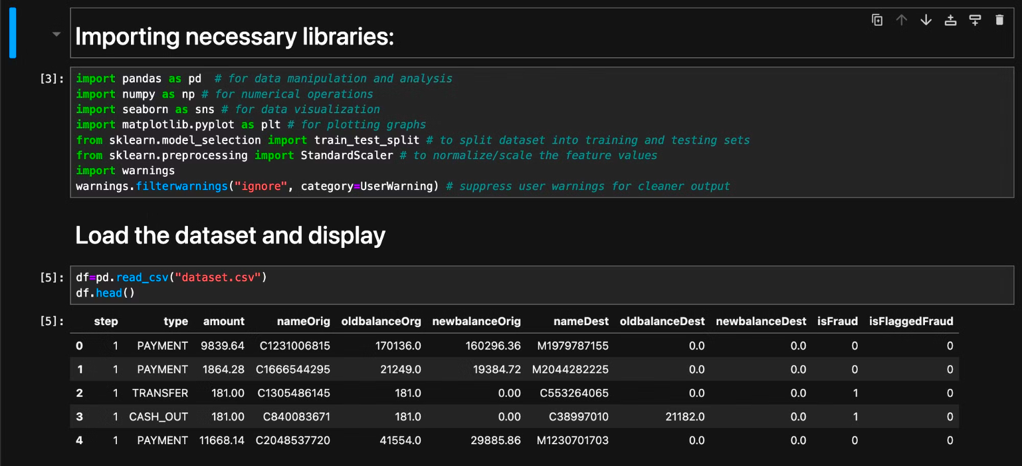
Sample Code:

Slide 12
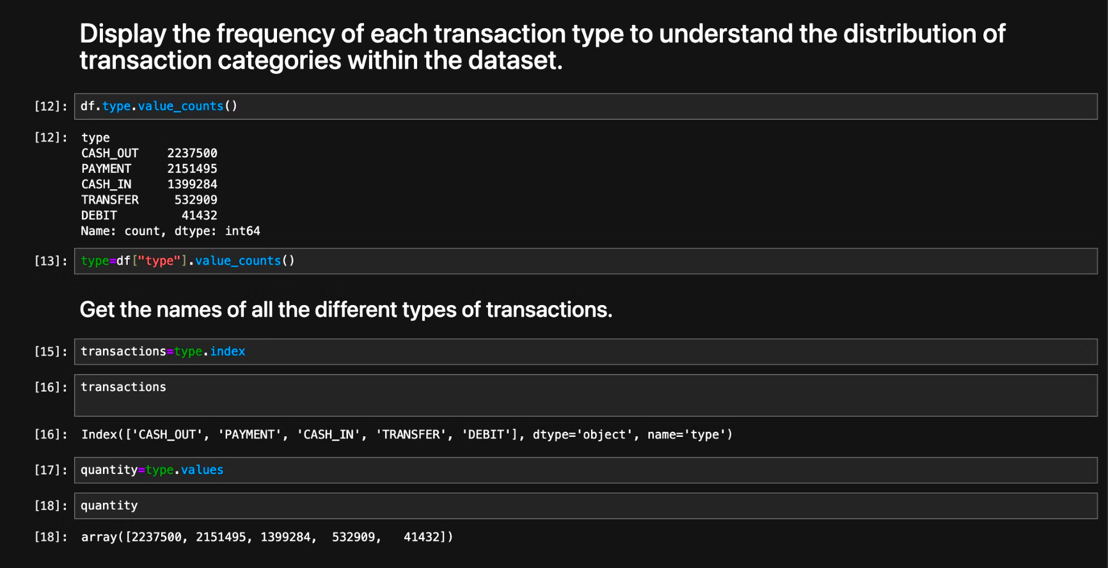

Slide 13
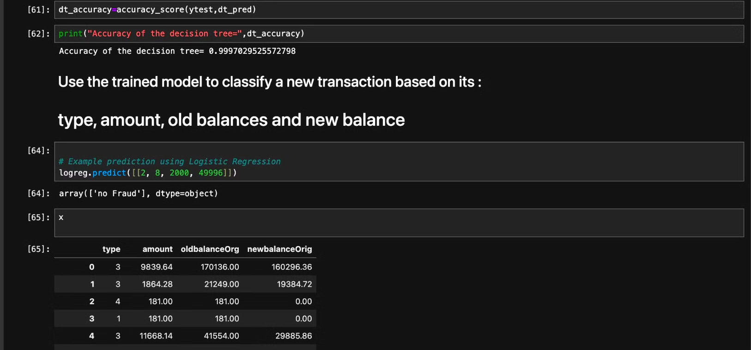

Slide 14
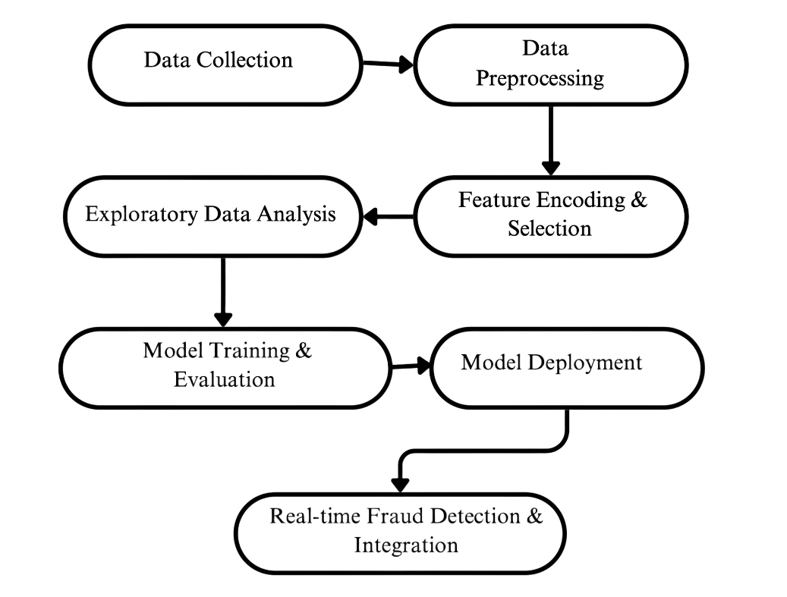
Architecture Diagram

Slide 15




Results and Discussions
Accuracy Metrics
Logistic Regression achieved approximately 97% accuracy in detecting fraudulent transactions.
Model Comparison
The Decision Tree model was simpler but exhibited slightly lower accuracy compared to Logistic Regression.
Fraud Rate
Analysis revealed that only about 0.17% of transactions in the dataset were fraudulent, highlighting the data imbalance.

Slide 16




Conclusion
1
Effective Detection
2
Accurate Results
3
Improved Outcomes
Machine Learning is highly effective for detecting online payment fraud. Logistic Regression provided the most accurate results. Preprocessing and scaling significantly improved outcomes, outperforming rule-based systems. This demonstrates the real-world value of data science in finance.

Slide 17

Future Work
Enhanced Models
Add more advanced models like Random Forest and deep learning models (ANN, LSTM) for improved accuracy.
Real-Time Prediction
Enable real-time fraud prediction using frameworks like Flask or Streamlit to deploy the models.
Advanced Analysis
Incorporate confusion matrices and ROC analysis for a more comprehensive performance evaluation.

Slide 18
References
Zhang, Z., Zhang, H., Guo, X., & Cheng, X. (2020). Online Payment Fraud Detection with a Novel Deep Belief Network Model. IEEE Access, 8, 151225-151236.
Yaseen, Z. M., & Al-Radaideh, Q. A. (2021). A Review of Machine Learning Techniques for Online Payment Fraud Detection. Computers, Materials & Continua, 68(3), 4053-4073.
Saleh, R. M., & Ahmed, A. M. (2019). Online Payment Fraud Detection Techniques: A Review. International Journal of Advanced Computer Science and Applications, 10(8), 312-317.

Slide 19

Publications
A recent study by Jovanovic, D., et al. (2022) explores modern approaches to fraud detection using artificial intelligence. Published in the International Journal of Advanced Computer Science and Applications (IJACSA), the research delves into the application of AI algorithms for identifying fraudulent patterns in online payment systems. The study was received on June 5, 2022, and published on June 29, 2022, representing current advancements in the field.

